Slide 1
MolSim WS 23/24
Sheet 1
Project Setup, Planetary Simulation
Group C [Manuel, Tobias, Daniel]
10/31/2023

Slide 2
N Body Simulation
Simulations with n ≤ 2:
Very stable and simple orbits
Often no approximations needed
Simulation with n ≥ 3:
Rarely analytic solution, approximation required
More complex orbits
Approximation artifacts

Slide 3
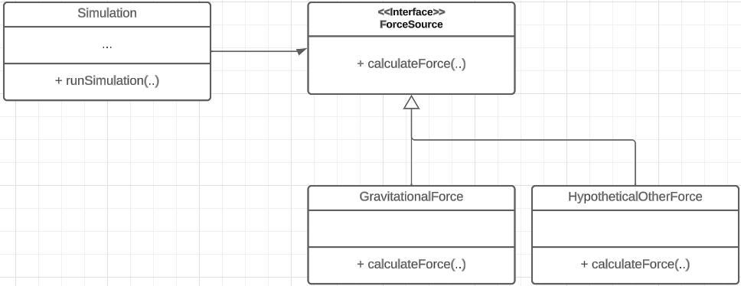
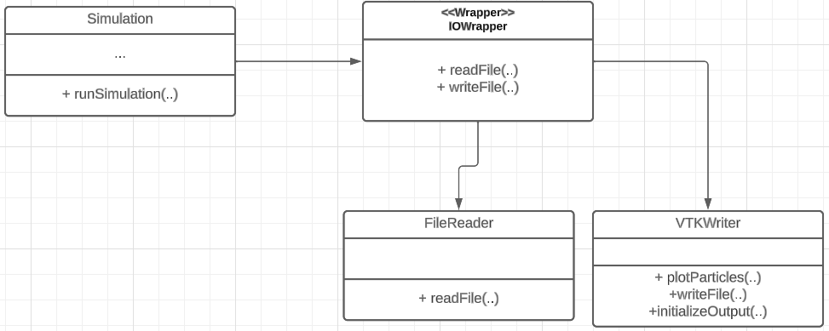
Code Refactoring
Design patterns used:
Adapter pattern
Bridge pattern
Goals:
Not having to change the code
structure much
Extend functionality easily

Slide 4
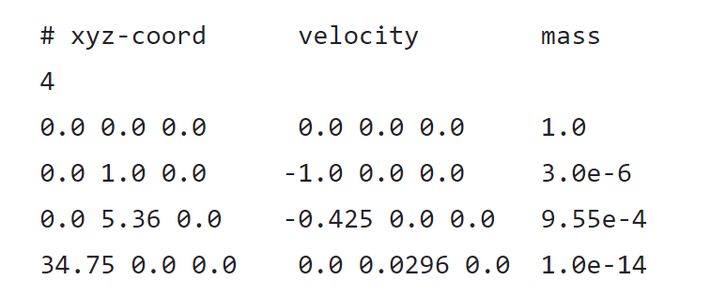
Input File Reverse Engineering
Input File isn’t labeled
⇒ Reverse engineer each body
Observation
Position in AUs
Mass normalized to sun
Therefore
Sun, Earth, Jupiter, Halley's Comet

Slide 5
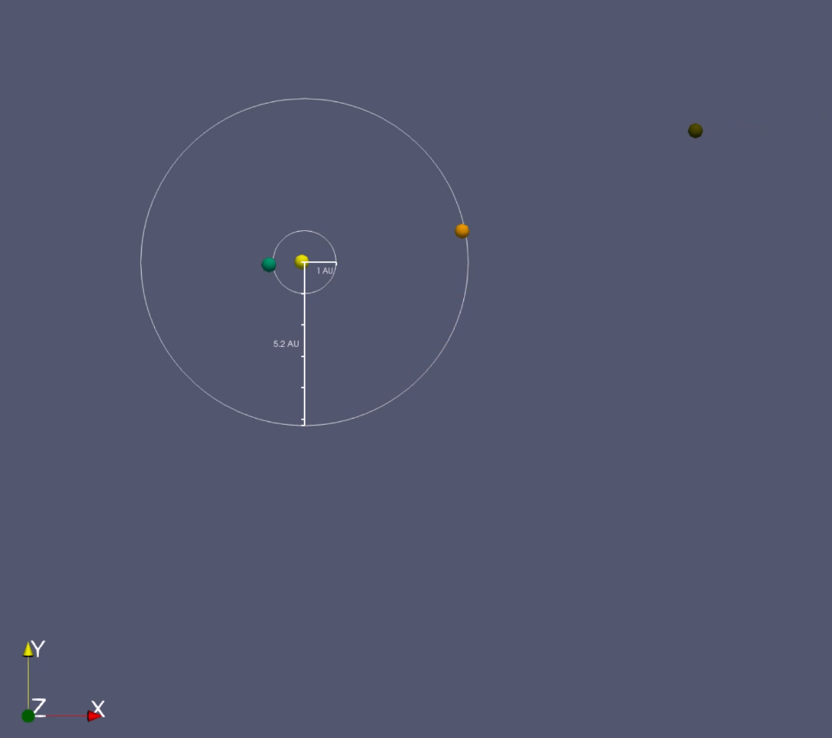
Visualization
Added some visuals to the simulation
Color represents planet type
Average orbit radius
Looks very cool!

Slide 6
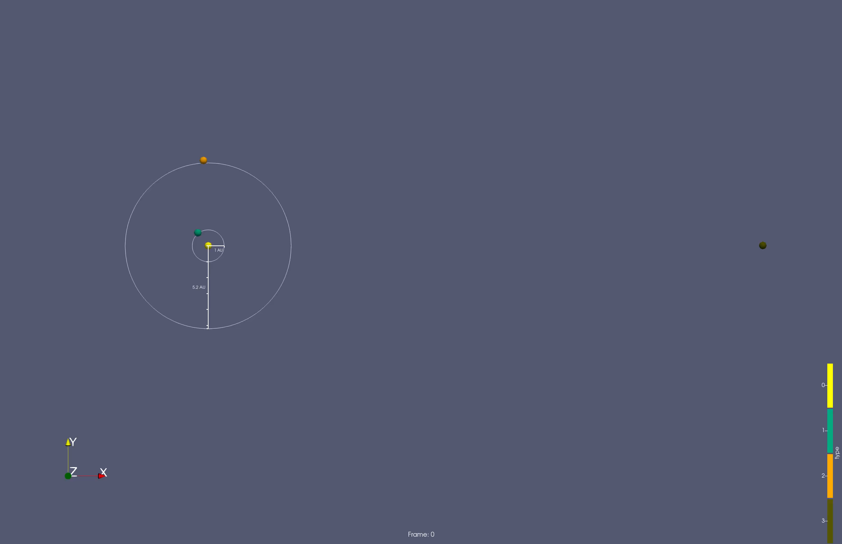
Visualization

Slide 7
Visualization

Slide 8
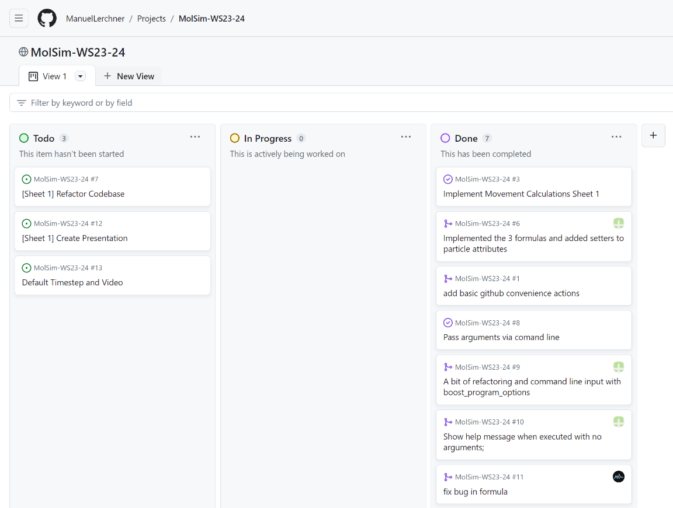
Github Project Management
Task Planning via Github
Kanban Board View
Easy way to see open issues

Slide 9
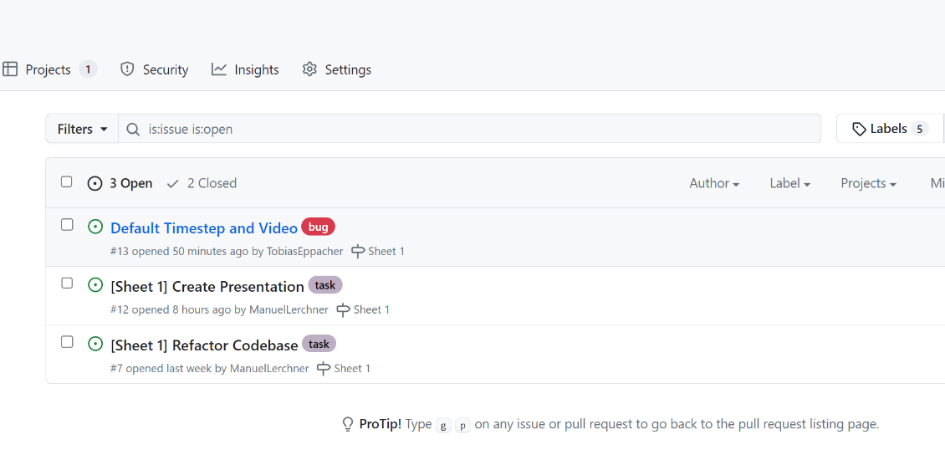
Github Issues
We organize open tasks in issues
Issues can be assigned to persons
Everyone can work in parallel
Hopefully not many merge conflicts

Slide 10
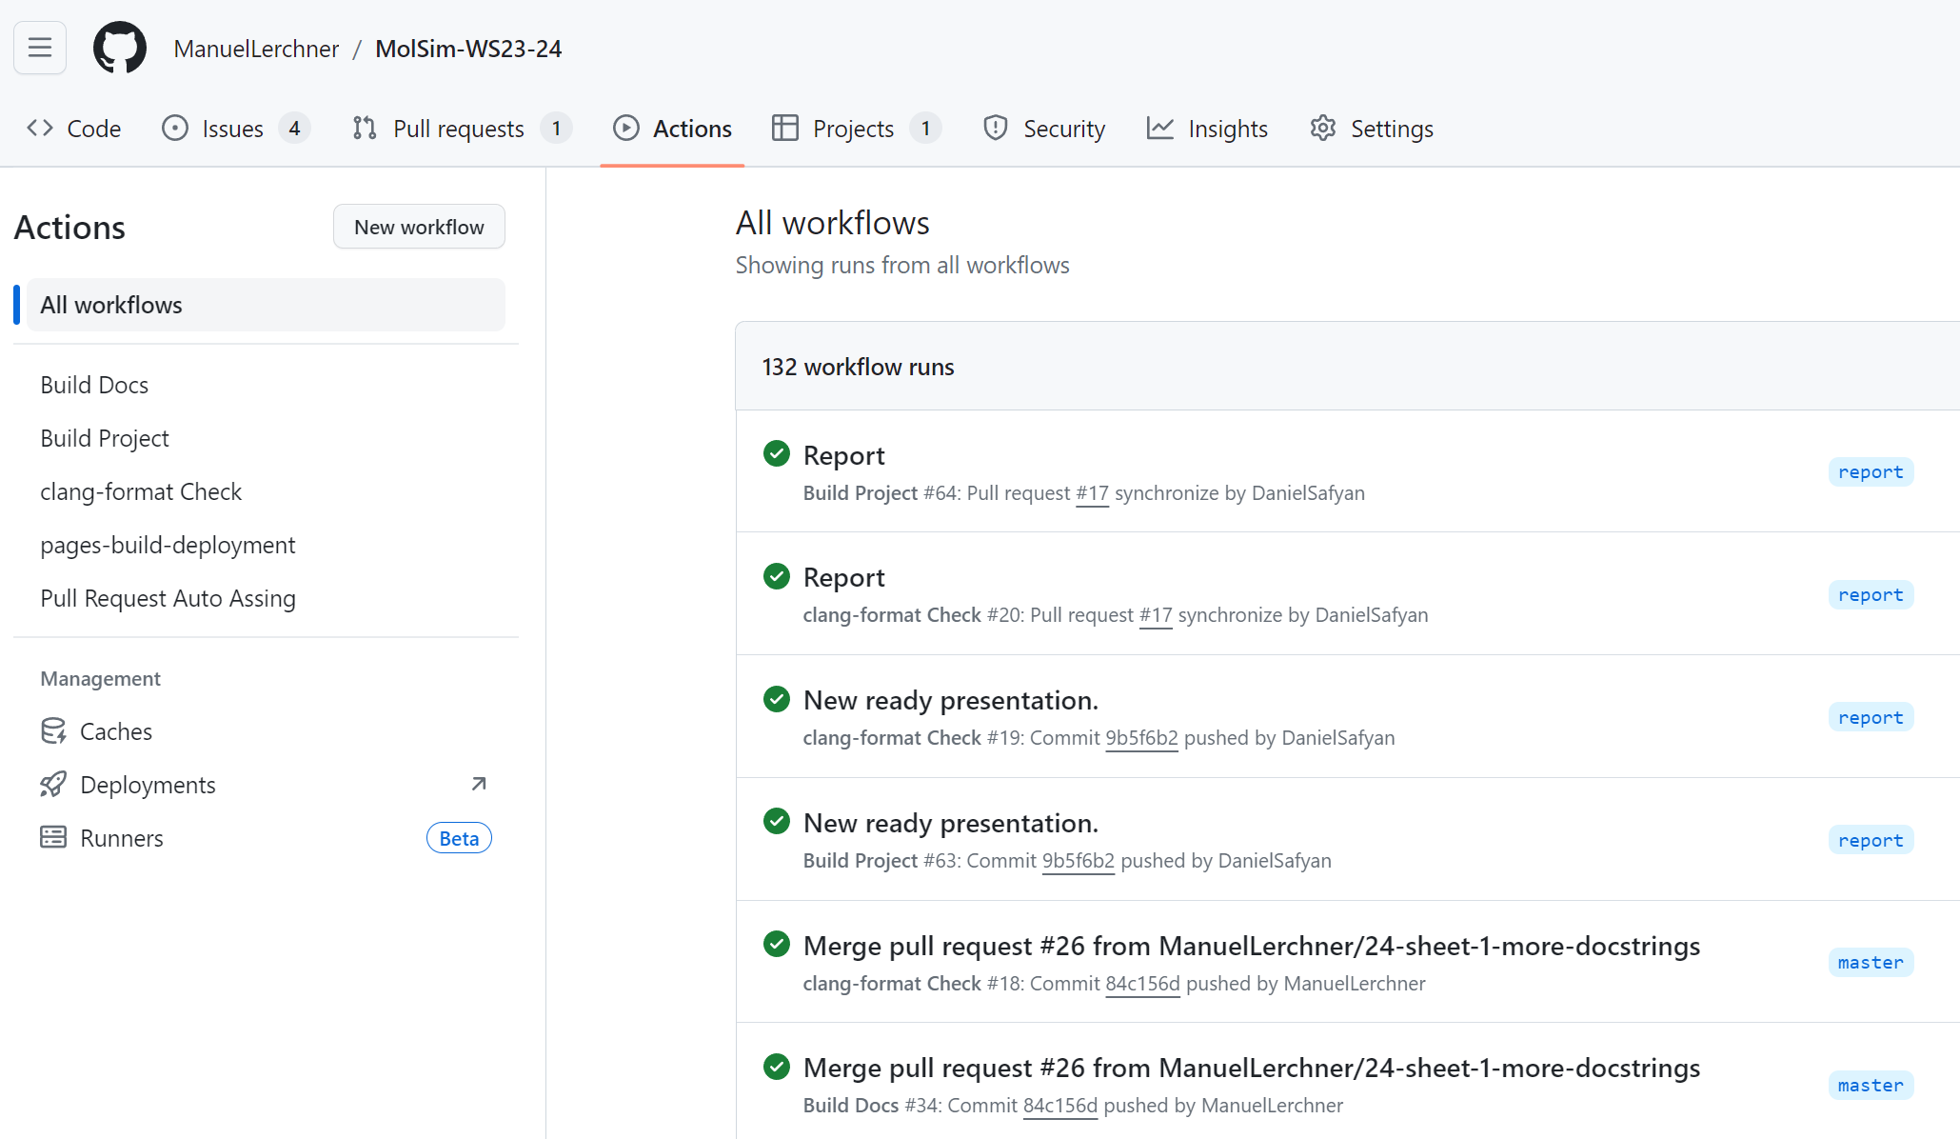
Github Actions
Small CI/CD pipeline
Build-Check
Compile source code
Run Doxygen
Format-Check
Host Docs on GitHub-Pages

Slide 11
Summary of cool things
We drew a pretty planet simulation
We used fancy software engineering patterns
Bridge Pattern
Adapter Pattern
We implemented a nice collaboration workflow
We set up a basic CI/CD pipeline

Slide 12
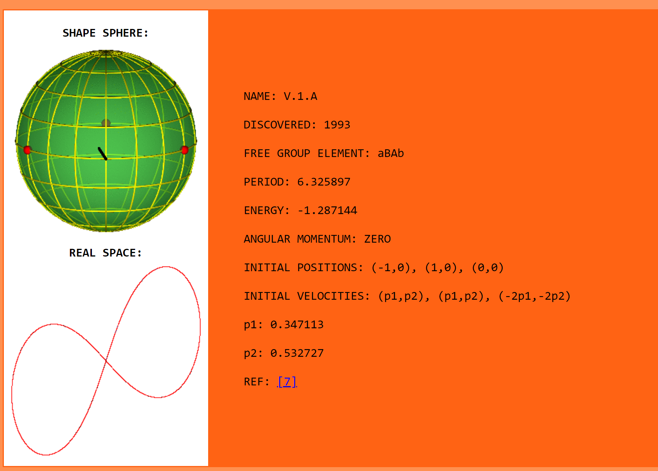
Perfectly periodic system

Slide 13
References
3-body-problem GIF: https://commons.wikimedia.org/wiki/File:Three-body_Problem_Animation_with_COM.gif
Figure 8 initial conditions: http://three-body.ipb.ac.rs/sV_sol.php?id=0

